Slide 1
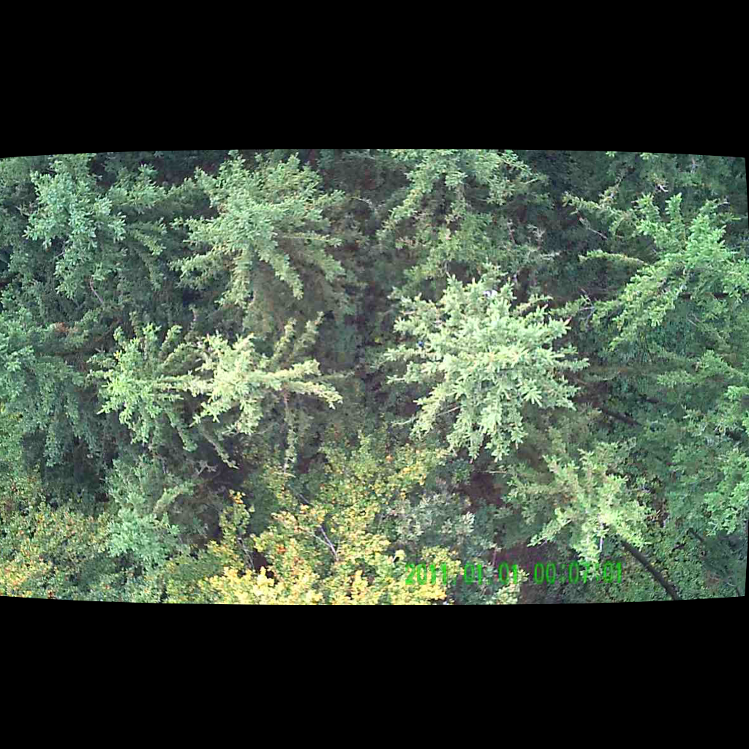
UNSUPERVISED PERSON LOCALIZATION IN WISAR Initial Ideas
Team C9
Nikolas Boldis Daniel Deutsch Lisa Schneckenreiter Uta Wagner
UE Computer Vision
9th December, 2021

Slide 2
Trying small Proof-of-concepts
First Image pre-processing
GAN seems to be too complex to be tuned in the allowed time frame
Autoencoder as a more simple variant seems more promising
UE Computer Vision, 9th December, 2021

Slide 3
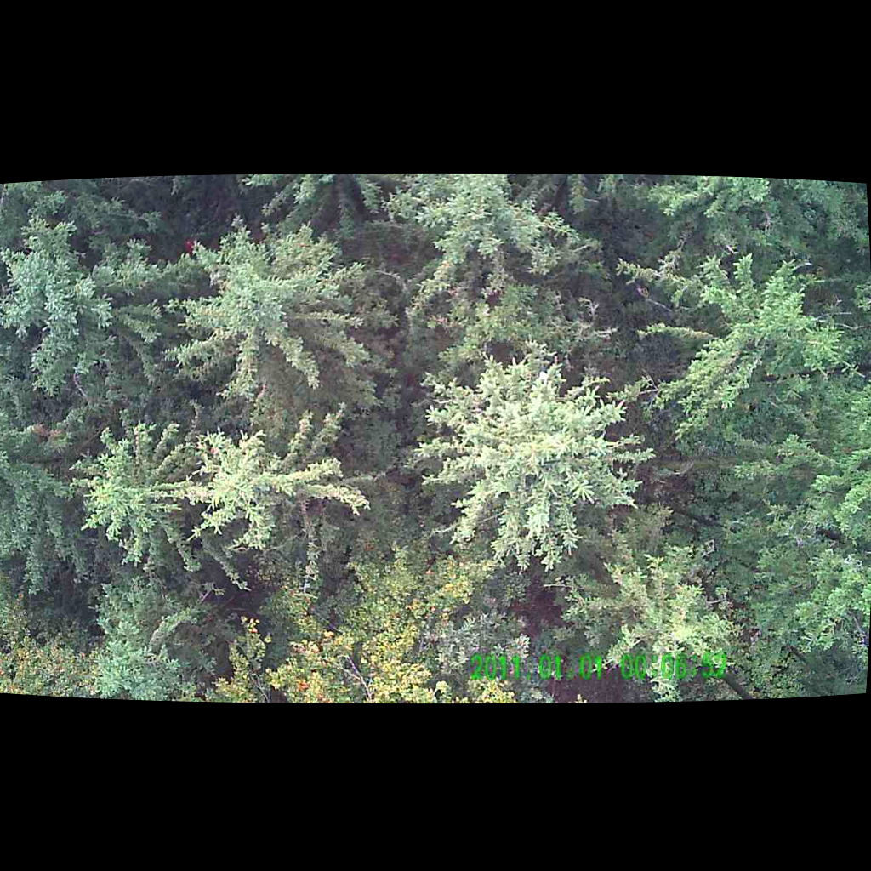
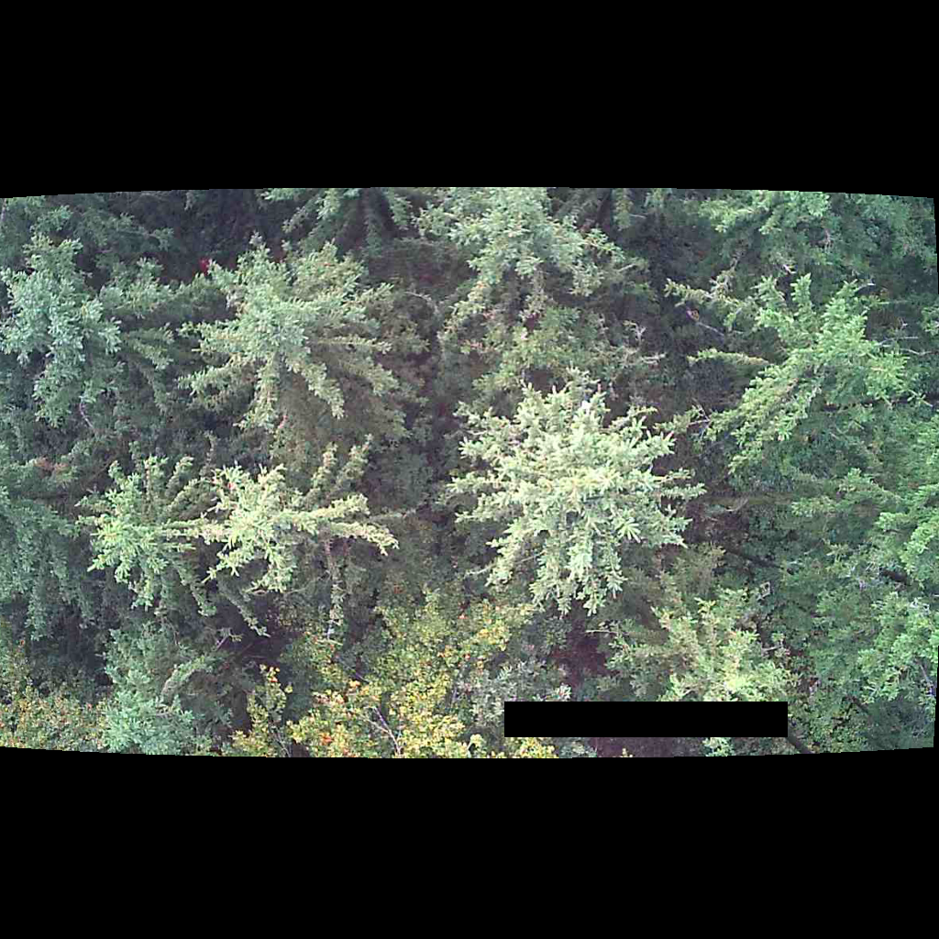

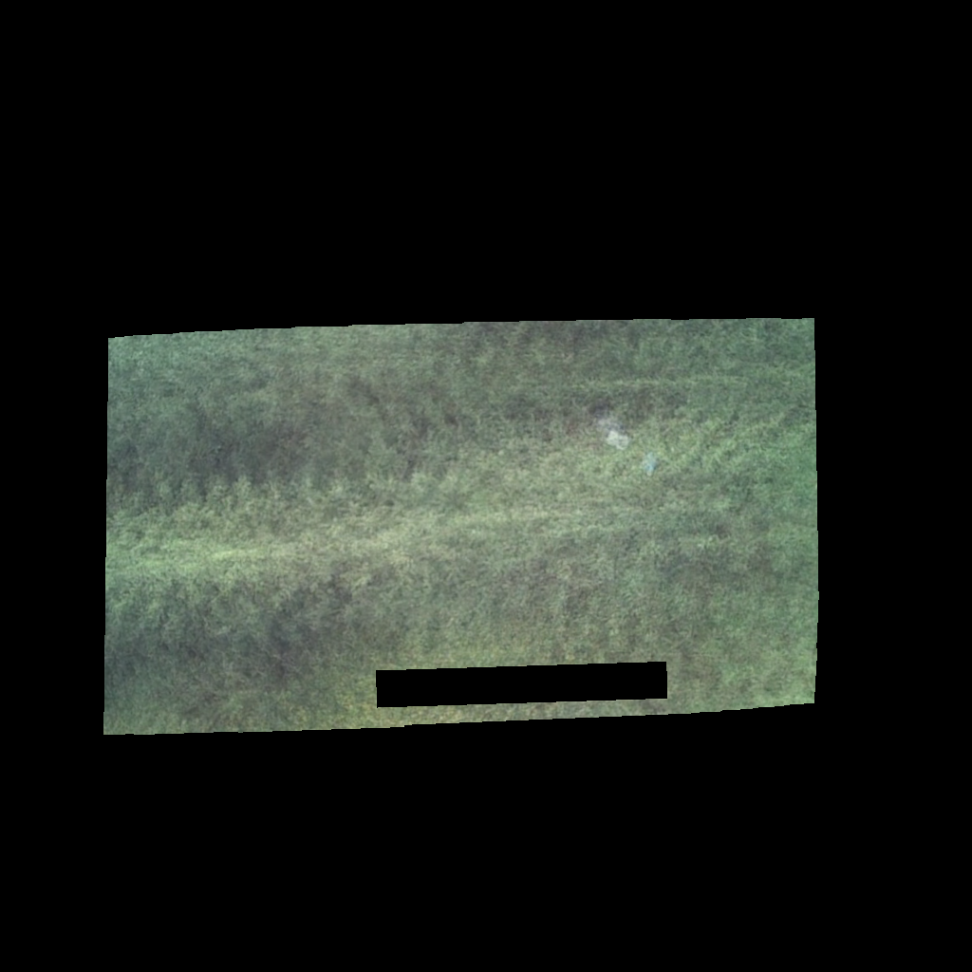
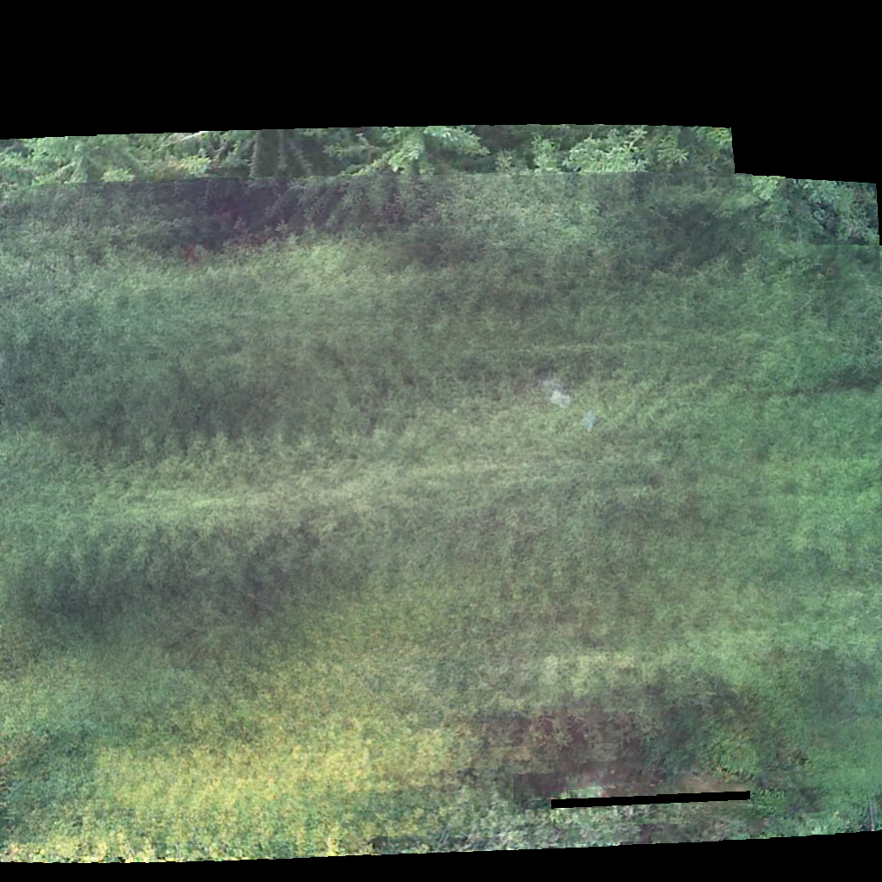
Image Pre-processing and Integration
1. apply mask for time stamp
2. warp to the same perspective
3. sum over parallel recorded images
4. remove areas not covered by all 10 images
UE Computer Vision, 9th December, 2021

Slide 4
Convolutional Autoencoder for Image Anomaly Detection
Autoencoder → encoder-decoder system to reconstruct the input as the output.
Train a convolutional autoencoder so that it will reconstruct an image from the normal data with a smaller reconstruction error, but reconstruct an image from the anomaly data with a larger reconstruction error
Our solution decides if an image is from the normal data or from the anomaly data based on a threshold of the reconstruction error.
UE Computer Vision, 9th December, 2021

Slide 5
Model is encouraged to learn to precisely reproduce the most frequently observed characteristics
When facing anomalies, the model should worsen its reconstruction performance.
After training, the autoencoder will accurately reconstruct normal data, while failing to do so with unfamiliar anomalous data
Reconstruction error (the error between the original data and its low dimensional reconstruction) is used as an anomaly score to detect anomalies
BUT certain autoencoding models can, counterintuitively, be very good at reconstructing anomalous examples and consequently not able to reliably perform anomaly detection
UE Computer Vision, 9th December, 2021

Slide 6
THANK YOU FOR YOUR ATTENTION!

